Slide 1

Seasonal Inventory Management
Case studies 5
Presented by:
Rohit Jain

Slide 2
Introduction
Toyjoy is a toy retail company that sells products through both physical stores and online platforms, that company observed that some products remained overstocked in warehouses while others frequently went out of stock during high demand periods. This analysis focuses on understanding sales patterns, inventory levels, and seasonal demand trends using historical data. By examining key metrics such as units sold, inventory turnover, stockout rates and revenue contribution, the goal is to identify inefficiencies in inventory planning. The insights from this analysis will help Toyjoy optimize stock levels, reduce excess inventory costs and ensure that high-demand products are available during peak seasons.

Slide 3
Business Background
You are a data analyst at Toyjoy, a company that sells toys through both retail stores and online channels. After the last holiday season, management noticed excess inventory of certain products, while others were frequently out of stock. They want to optimize inventory planning to reduce overstock, avoid stockouts and improve cash flow.

Slide 4
Business Objective
Identify products with high overstock and low sales.
Predict demand trends based on seasonality and historical sales.
Recommend inventory adjustments to minimize waste and lost sales.

Slide 5
KPI’s
The following KPIs were used to measure performance:
Inventory Turnover - Shows how quickly inventory is sold and replaced during a period.
Average Inventory - Represents the average stock level available over a specific time.
Total Units Sold - Total number of products sold in the selected period.
Total Revenue - Total income generated from product sales.

Slide 6
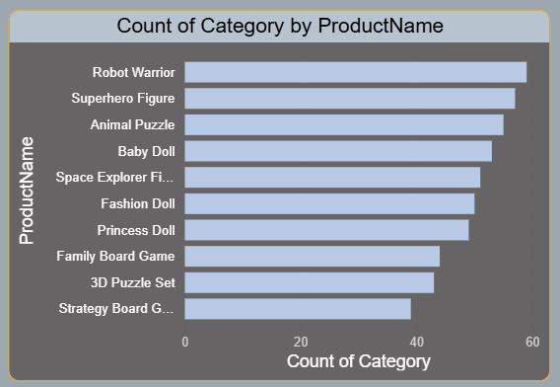
Business Questions / Challenges
Which products or categories have excess inventory that ties up capital?
Shows how many products exist in each category.
Some categories have more product variety than others.
Helps in understanding product distribution.

Slide 7
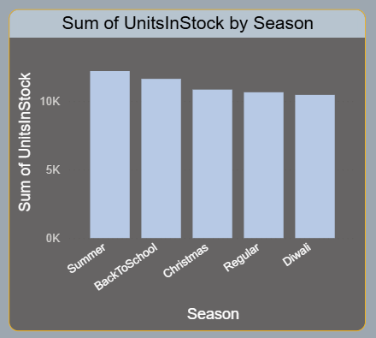
Business Questions / Challenges
Can you identify seasonal trends in sales to guide stocking for the next period?
Stock levels are highest in Summer and Back-to-School.
Slight decrease in Diwali and Regular seasons.
Indicates seasonal inventory planning.

Slide 8
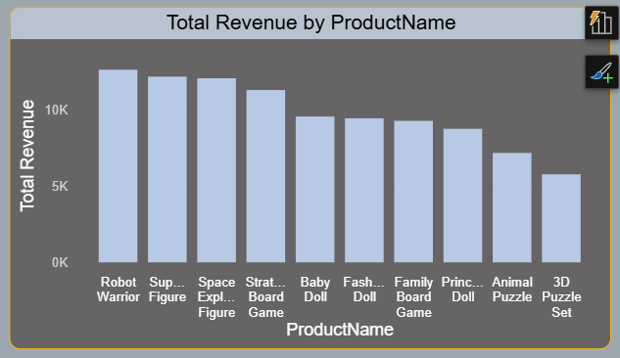
Business Questions / Challenges
There are products that all given revenue
Shows which products generate the highest revenue.
Products like Robot Warrior and Superhero Figure perform best.
Some products have much lower revenue → improvement needed.

Slide 9
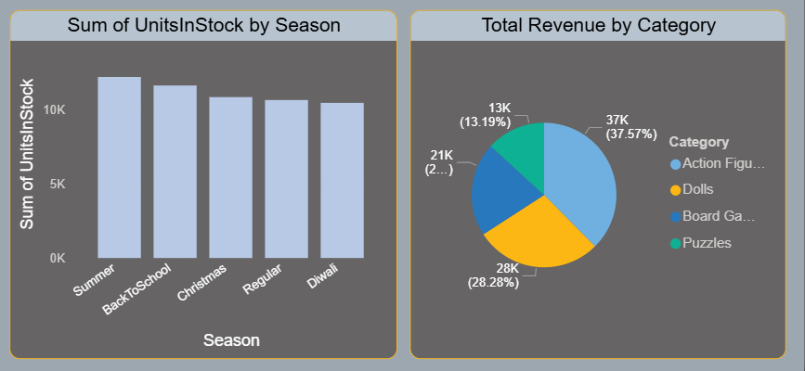
Business Questions / Challenges
Action Figures contribute the highest share of revenue.
Dolls and Board Games also contribute significantly.
Puzzles have the lowest revenue share.

Slide 10
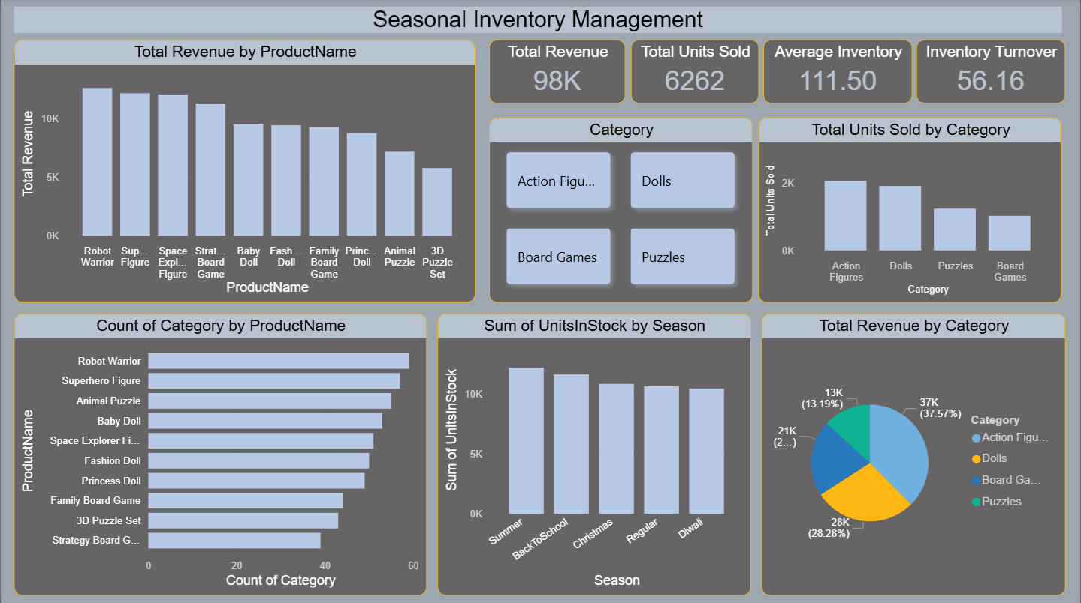
Dashboard

Slide 11
Recommendations
Reduce inventory of slow-moving products to avoid excess stock and holding costs.
Ensure proper stocking of high-demand products to prevent stockouts and lost sales.
Use seasonal demand forecasting to plan inventory more accurately for peak periods.
Optimize inventory allocation across categories to improve cash flow and warehouse efficiency.

Slide 12
Conclusion
The analysis of Toyjoy’s inventory and sales data highlights clear differences in product demand across categories and seasons. Some products maintain high stock levels despite low sales resulting in excess inventory and increased holding costs. At the same time, several high-demand items experience stock shortages, leading to missed revenue opportunities. Prioritizing restocking for high-demand products reducing stock for slow-moving items and implementing better forecasting methods will help minimize stockouts and overstock situations. These strategies will ultimately improve cash flow, optimize warehouse capacity and support better decision-making for future inventory planning.

Slide 13
THANK YOU!

